Slide 1
Cover Page
Introduction to REST API
Presented by
Jonathan Chung
Revision Date
14/05/2026

Slide 2
Cover Page
About Me
Jonathan Chung Ka Heng Chief Technology Officer
Over 7 years Employed under

Slide 3
Cover Page
Overview
Workshop
1 Hour
Explanation on the key concepts
Sample codes
1 Hour
Trial run and Q&A

Slide 4
Cover Page
Tools
Code Editor
Visual Studio Code
Database Viewer
DBeaver
Software (In order of top to bottom)
NodeJS – v24.10.0 (LTS)
Bun
Python – v3.14.3
UV
Git
Repository
https://github.com/Atsukio/REST-API-Workshop

Slide 5
Cover Page
Tools
READY CHECK

Slide 6
Cover Page
Tools
You’ve started your backend server `uv run python manage.py runserver`
You’ve started your frontend server `bun run dev`
You’ve started loading the frontend `http://localhost:3000`
You’ve started loading the backend `http://127.0.0.1:8000/api/docs`

Slide 7
Cover Page
Frameworks
Development Stacks
Frontend
Nuxt.JS (Javascript Framework built on Vue.JS)
Backend
Django (Python)

Slide 8

Cover Page
REST API
Conventions
Convention
CRUD Methodology
C – Create – Creating a new object (POST)
R – Retrieve – Retrieving existing data (GET)
U – Update – Updating existing data (PUT / PATCH)
D – Delete – Deleting existing data
Use Case
Mobile application development
Web application development without server-side rendering
Etc

Slide 9

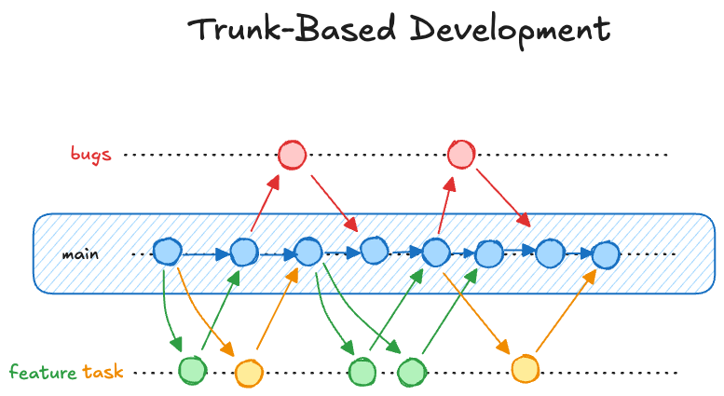
Cover Page
Trunk-Based Development
Git Workflows
Important notes:
Higher-risk nature
Not junior dev friendly
Requires developers who test heavily before release
Faster release than branch-based
Less merge conflicts
Document reference:​ https://dev.to/glnurltn/trunk-based-vs-branch-based-development-which-strategy-fits-your-team-best-53hn​

Slide 10
Cover Page
Gitflow
Git Workflows
Examples of branches:
main
develop
hotfix/page-crash
release/1.0.0
feature/todo-page
Document reference:​ https://www.atlassian.com/git/tutorials/comparing-workflows/gitflow-workflow​

Slide 11

Cover Page
Conventional Commits
Git Commit Standards
Commit Message | Description
fix | a commit noting a fix to the codebase
feat | a commit of the type feat introduces a new feature to the codebase
BREAKING CHANGE | specified at the start or end of the commit, noting the commit will cause changes that will break changes such as to the API.
! | can be used together with commit prefixes to indicate there's a BREAKING CHANGE
Document reference:​ https://www.conventionalcommits.org/en/v1.0.0-beta.4/#specification

Slide 12
Cover Page
Conventional Commits
Other kinds of Git Commit Standards
Commit Message | Description
chore | a commit that does not affect code changes, e.g. adding comments
docs | a commit to update documentation
style | a commit noting visual changes such as css
refactor | a commit noting a rework in the codebase
perf | a commit noting a performance change such as performance improvements
test | a commit noting changes or additions to the test cases
Document reference:​ https://www.conventionalcommits.org/en/v1.0.0-beta.4/#specification

Slide 13

Cover Page
Conventional Commits
Git Commit Standards
Commit message with description and breaking change in body
feat: allow provided config object to extend other configs
BREAKING CHANGE: `extends` key in config file is now used for extending other config files
Commit message with optional ! to draw attention to breaking change
chore!: drop Node 6 from testing matrix
BREAKING CHANGE: dropping Node 6 which hits end of life in April
Commit message with no body
docs: correct spelling of CHANGELOG
BREAKING CHANGE: dropping Node 6 which hits end of life in April
Commit message with scope
feat(lang): add polish language
Commit message for a fix using an (optional) issue number.
fix: correct minor typos in code see the issue for details on the typos fixed closes issue #12

Slide 14
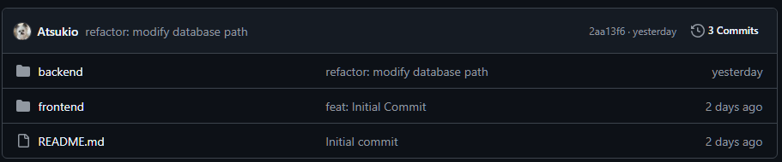
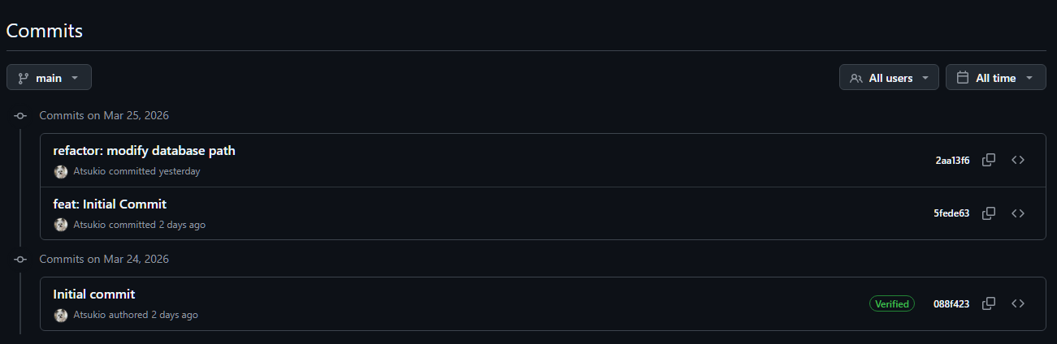
Cover Page
Conventional Commits
Git Commit Standards

Slide 15
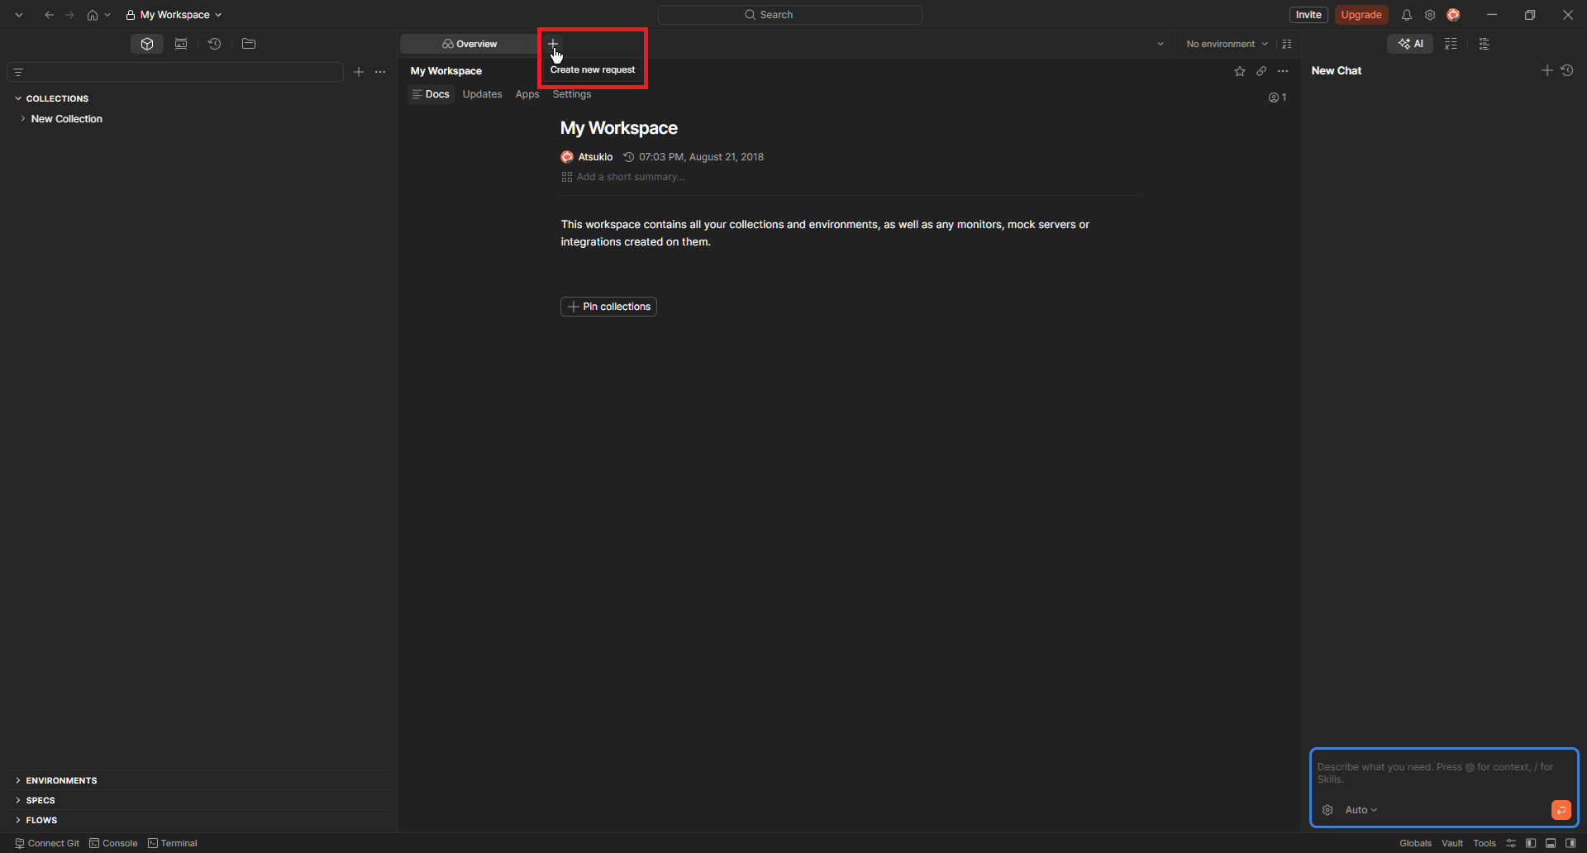
Cover Page
Postman
Now you try

Slide 16




Cover Page
Q&A

Slide 17

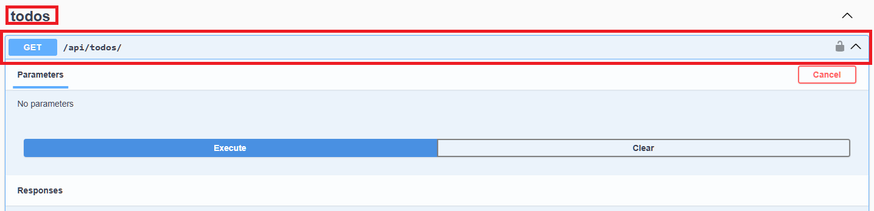
Cover Page
Postman
Now you try
Head over to http://localhost:8000/api/docs/
Expand on the “todos” dropdown
The URL would be the website, in our case http://localhost appended with the api in this case “/api/todos/” which would look like http://localhost/api/todos/

Slide 18
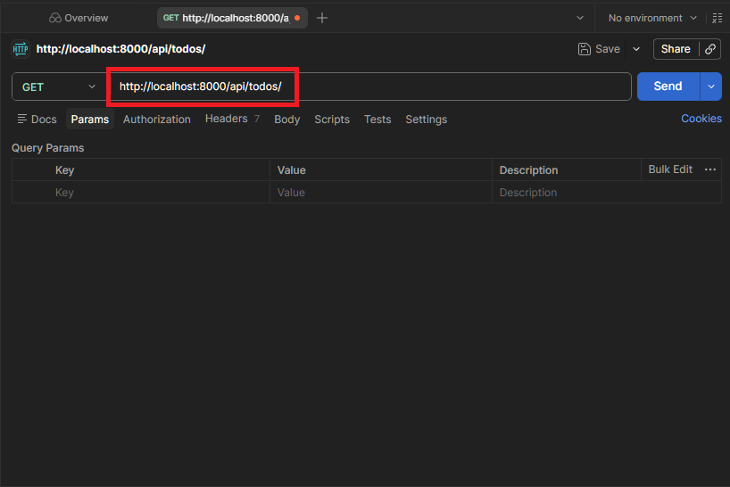
Cover Page
Postman
Now you try
Fill in the URL with the API endpoint

Slide 19
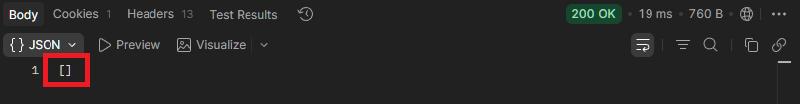
Cover Page
Postman
Now you try
Time taken
The result
Status code

Slide 20

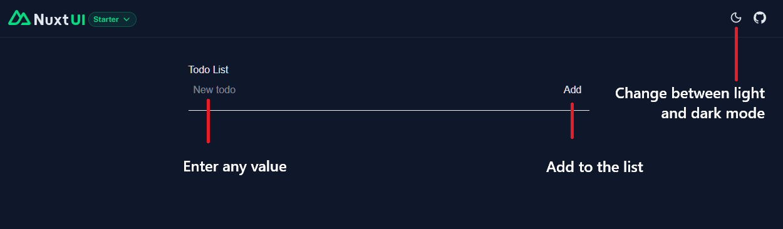
Cover Page
Website
Now you try
Head over to http://localhost:3000/

Slide 21
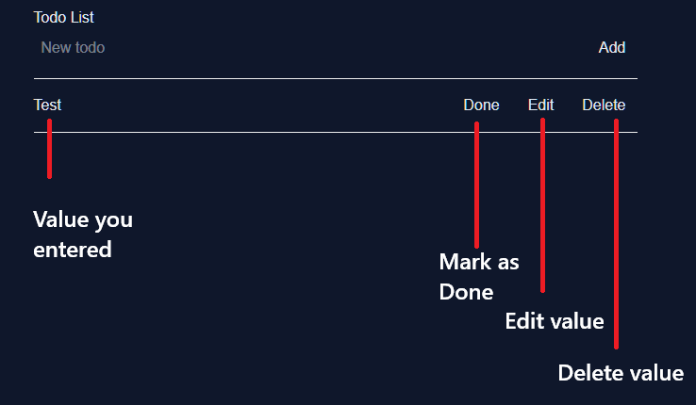
Cover Page
Website
Now you try
This intentionally doesn’t work

Slide 22
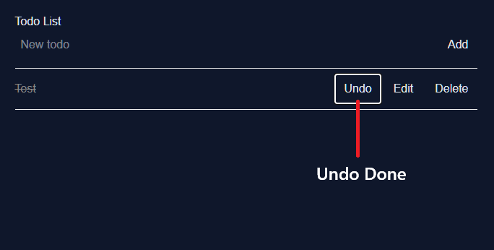
Cover Page
Website
Now you try

Slide 23
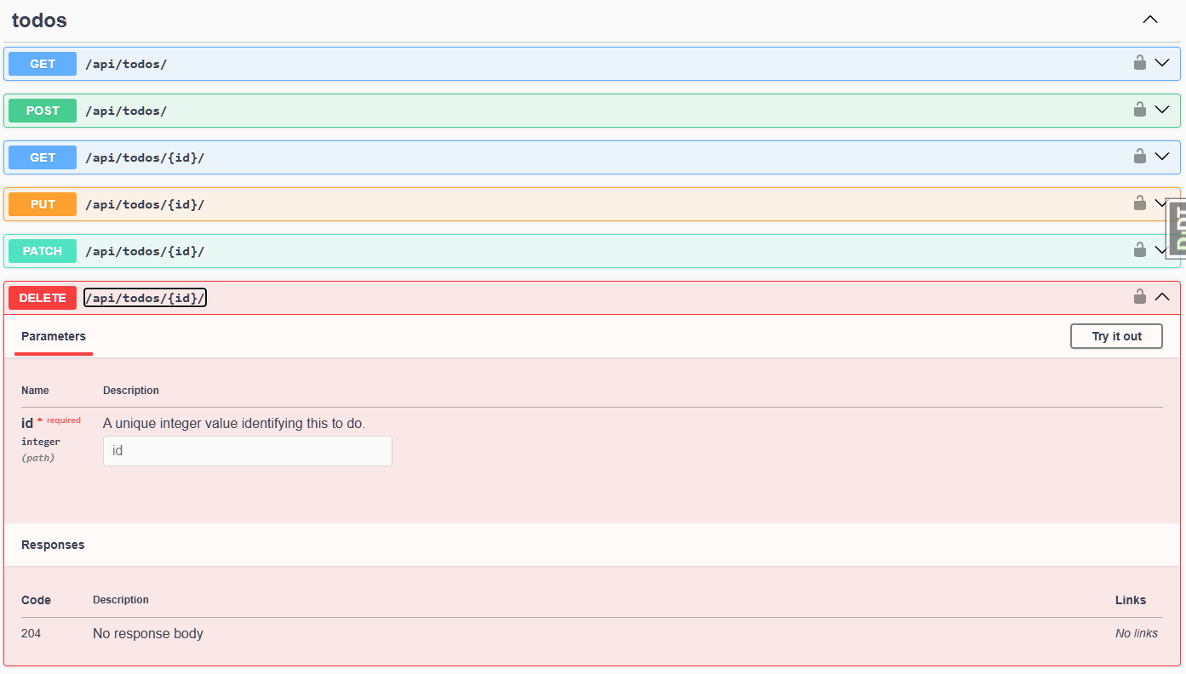
Cover Page
Back to Postman
Now you try
Head over to http://localhost:8000/api/docs/
The URL would be the website, in our case http://localhost appended with the api in this case “/api/todos/{id}/” which would look like http://localhost/api/todos/1/

Slide 24
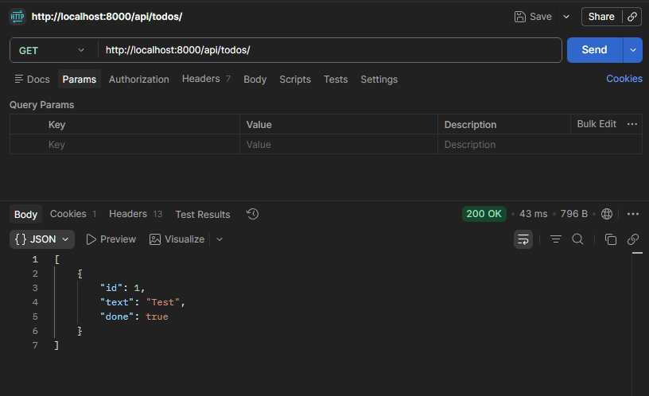
Cover Page
Back to Postman
Now you try
The id we’ll be using

Slide 25
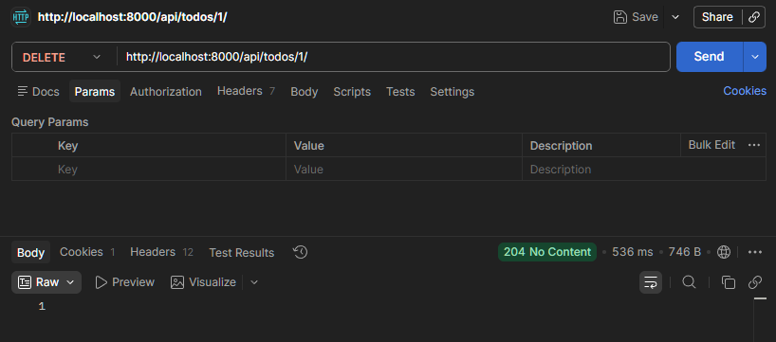
Cover Page
Back to Postman
Now you try
API Method
The ID from the API GET response
There’s no response as delete doesn’t return a response value
204 means it’s successful but it has no content to return

Slide 26




Cover Page
Q&A

Slide 27

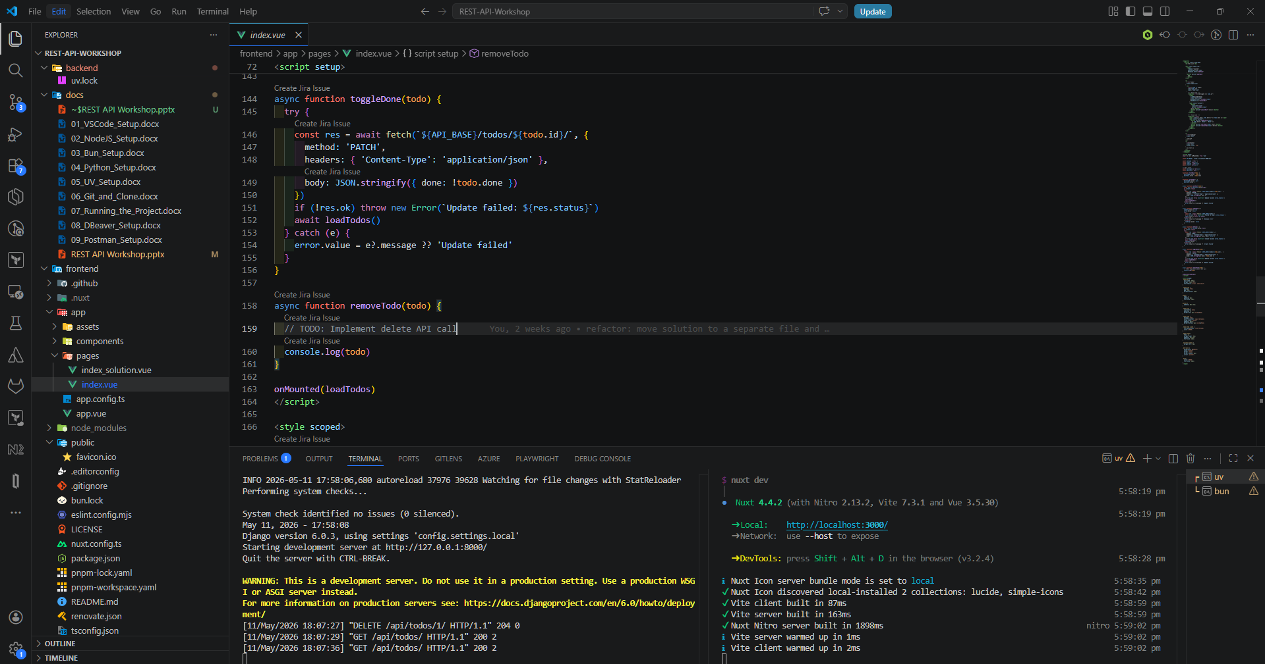
Cover Page
Visual Studio Code
Now you try
Inside: frontend > app > pages > index.vue on line 159

Slide 28
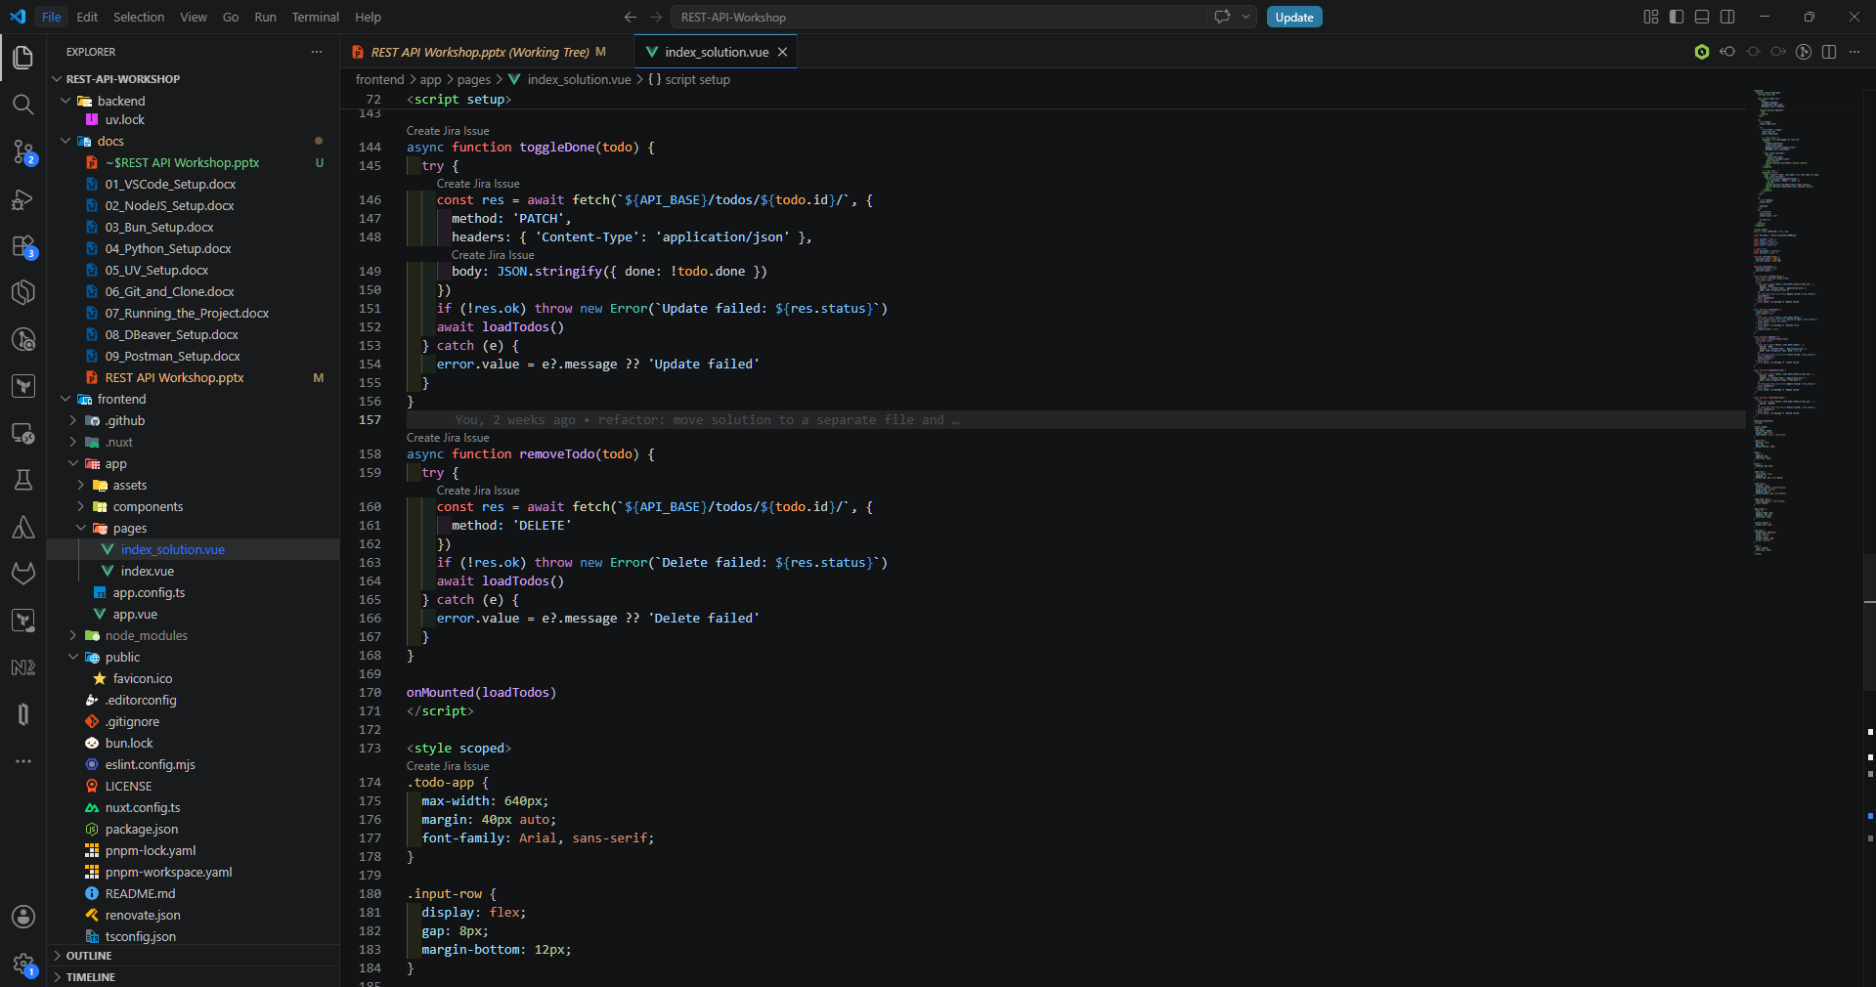
Cover Page
Visual Studio Code
Solution
Solution inside: frontend > app > pages > index_solution.vue on line 159

